Slide 1
夥伴商店計劃最新資訊
Updates on Partner Store Program
Marcus Chan
商業夥伴拓展經理
Affiliate Development Manager
本簡報中提到的收入等級純屬舉例說明，無意代表美安香港超連鎖™店主的一般收入，也無意表示任何超連鎖™店主皆可賺取同等收入。美安香港超連鎖™店主的成功與否，取決於其在發展事業時的努力、才能與投入程度。
The income levels mentioned in the following presentation are for illustration purposes only. They are not intended to represent the income of a typical Market Hong Kong UnFranchise ™Owner, nor are they intended to represent that any given Independent UnFranchise ™ Owner will earn income in that amount. The success of any Market Hong Kong Independent UnFranchise ™ Owner will depend upon the amount of hard work, talent, and dedication which he or she devotes to building his or her Market Hong Kong Business.

Slide 2
HK.SHOP.COM
Partner Store

Slide 3
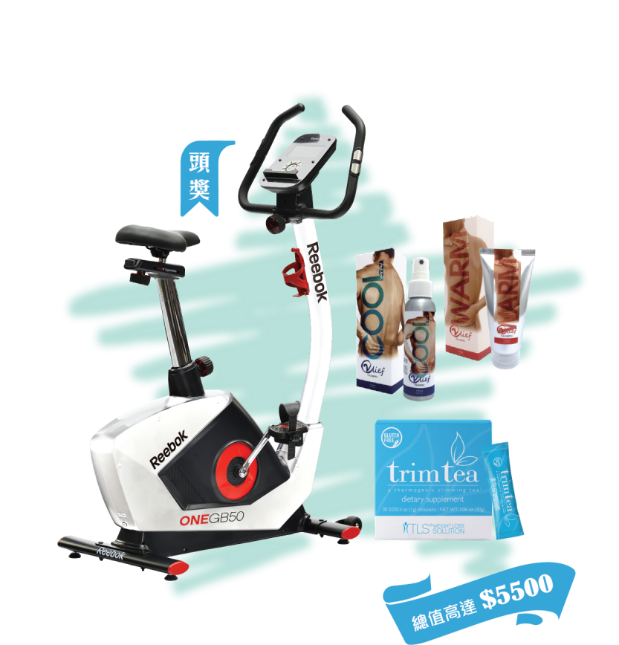
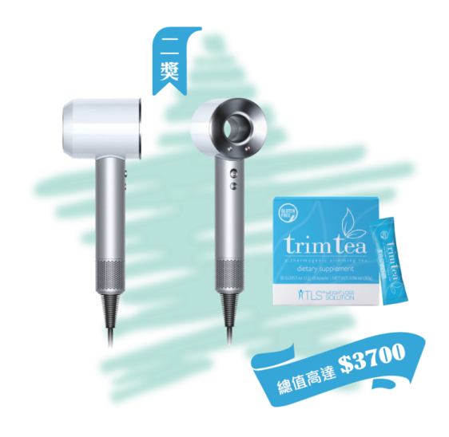
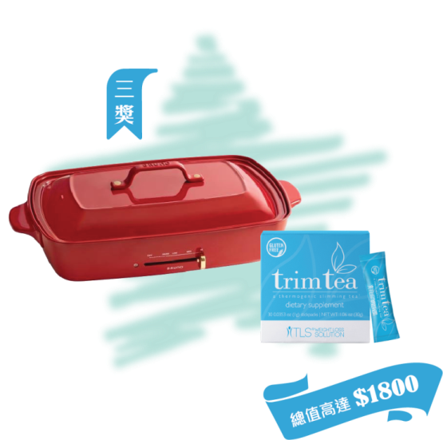
Guess the total number of Trim tea placing in the entrance, then you have the chance to get the prize award worth over HK$5,500 !
Start time：12 May at 10am
End time： 13 May at 3pm
Announcement time：13 May Ending

Slide 4
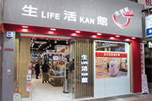
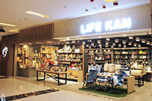
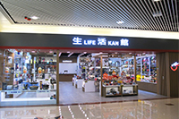
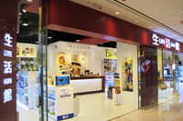
Life Kan stores：
Times Square, Causeway Bay
Hennessy Road, Wan chai
K11, TST
Plaza Hollywood, Diamond Hill
Domain, Yau Tong
Maritime Square, Tsing Yi
MHK Privilege Offer
15% discount on regular-priced items
5% discount on special priced items and electrical products
All retail stores of
Life Kan & Life@Home joined HK.SHOP.COM
on April 2018
Life@Home stores:
Tai Wo Plaza, Tai Po
Temple Mall South,
Wong Tai Sin

Slide 5
JULY
SPECIAL PRIVILEGE OFFER for HK.SHOP.COM
の
MEMBER SHOPPING DAY
LIFE KAN STORE AT K11, TST
Sh pping
day

Slide 7
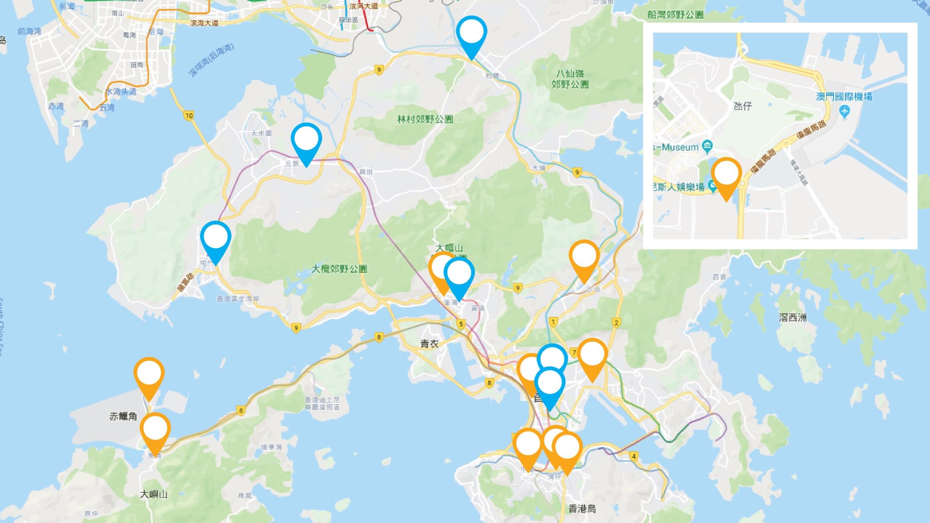
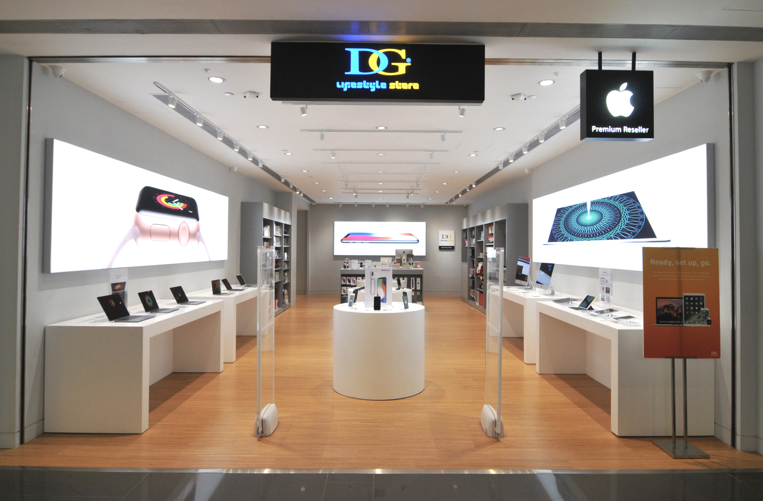
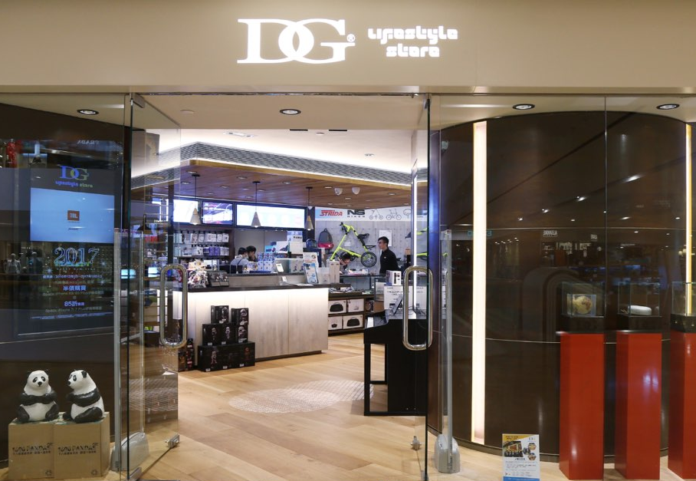
澳門1間分店
新界7間分店
6 retail stores in HK
8 retail stores in HK
1 retail store in Macau
九龍4間分店
香港3間分店

Slide 8
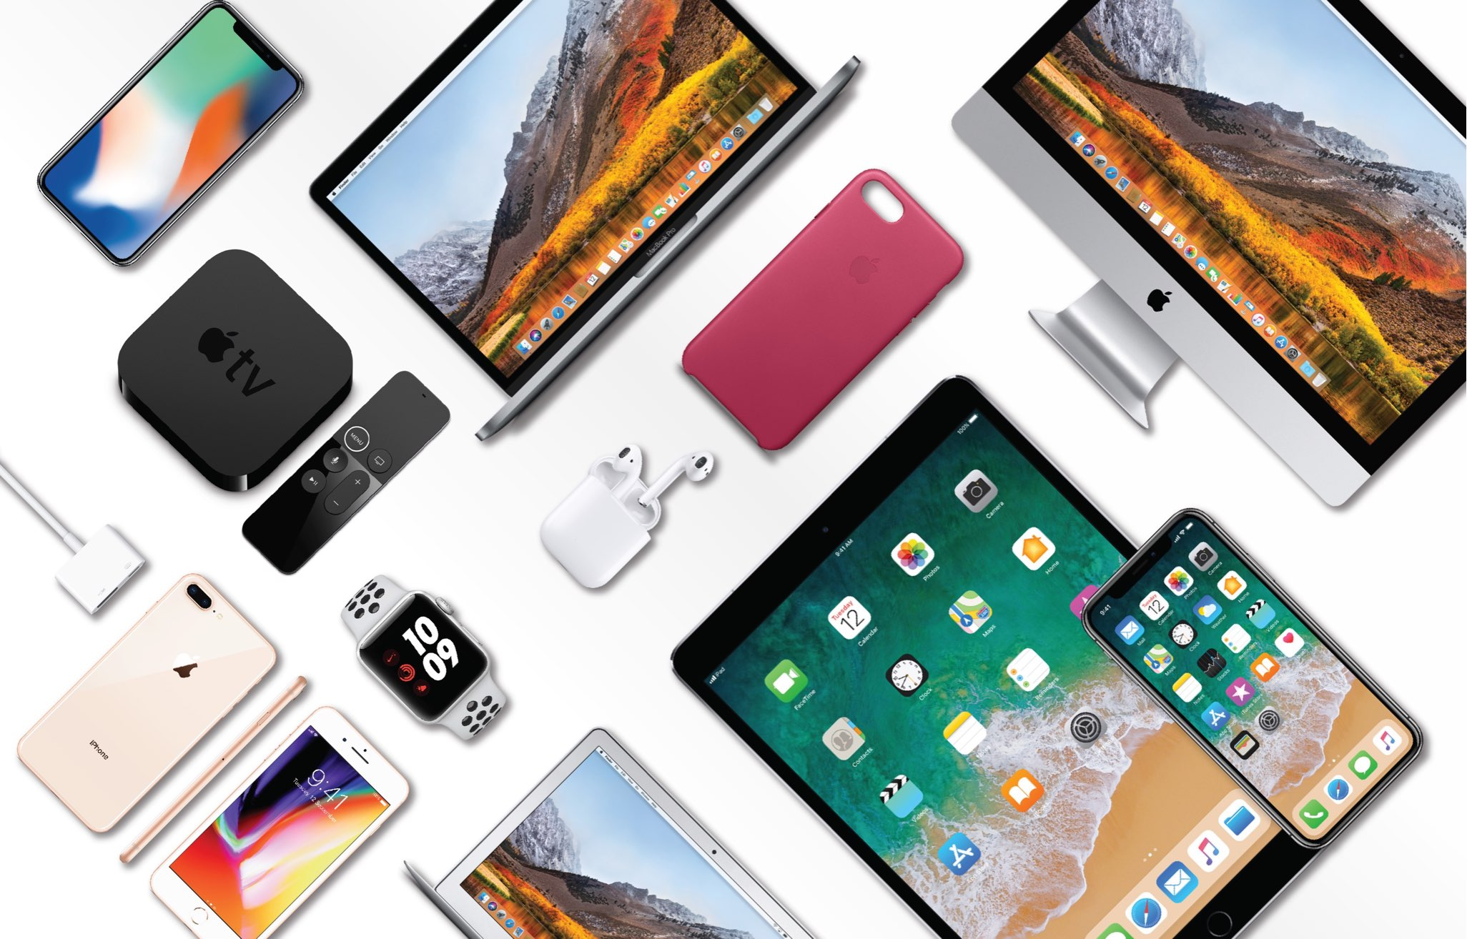
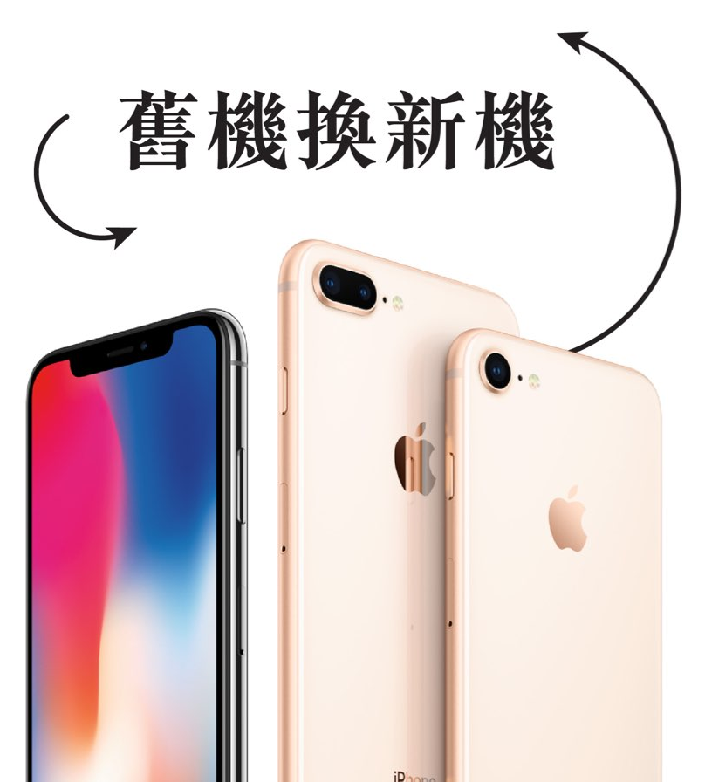
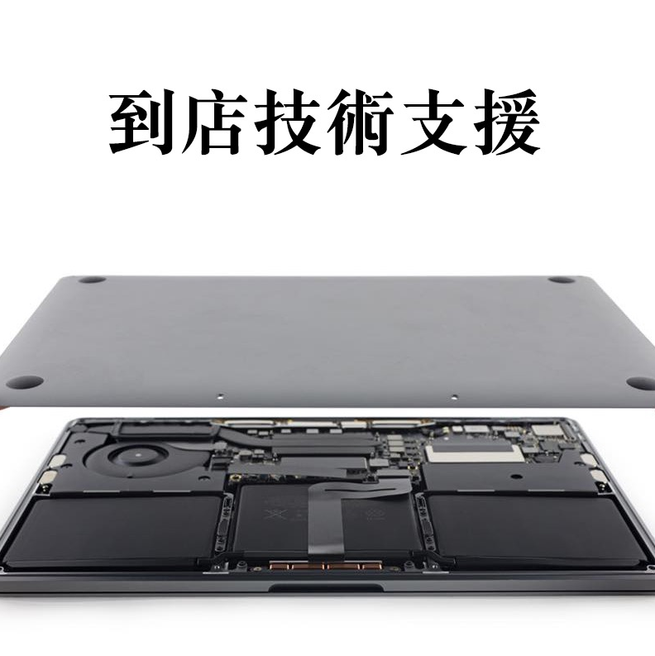
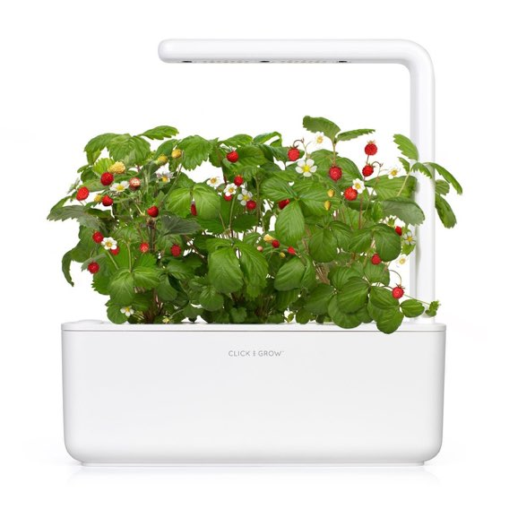
The most completed range of
Apple product
Apple Security Certification
Wire / power supply
Popular
Audio products
Smart live products
Protective case
Other brands products
Your intimate expert of Apple products

Slide 9
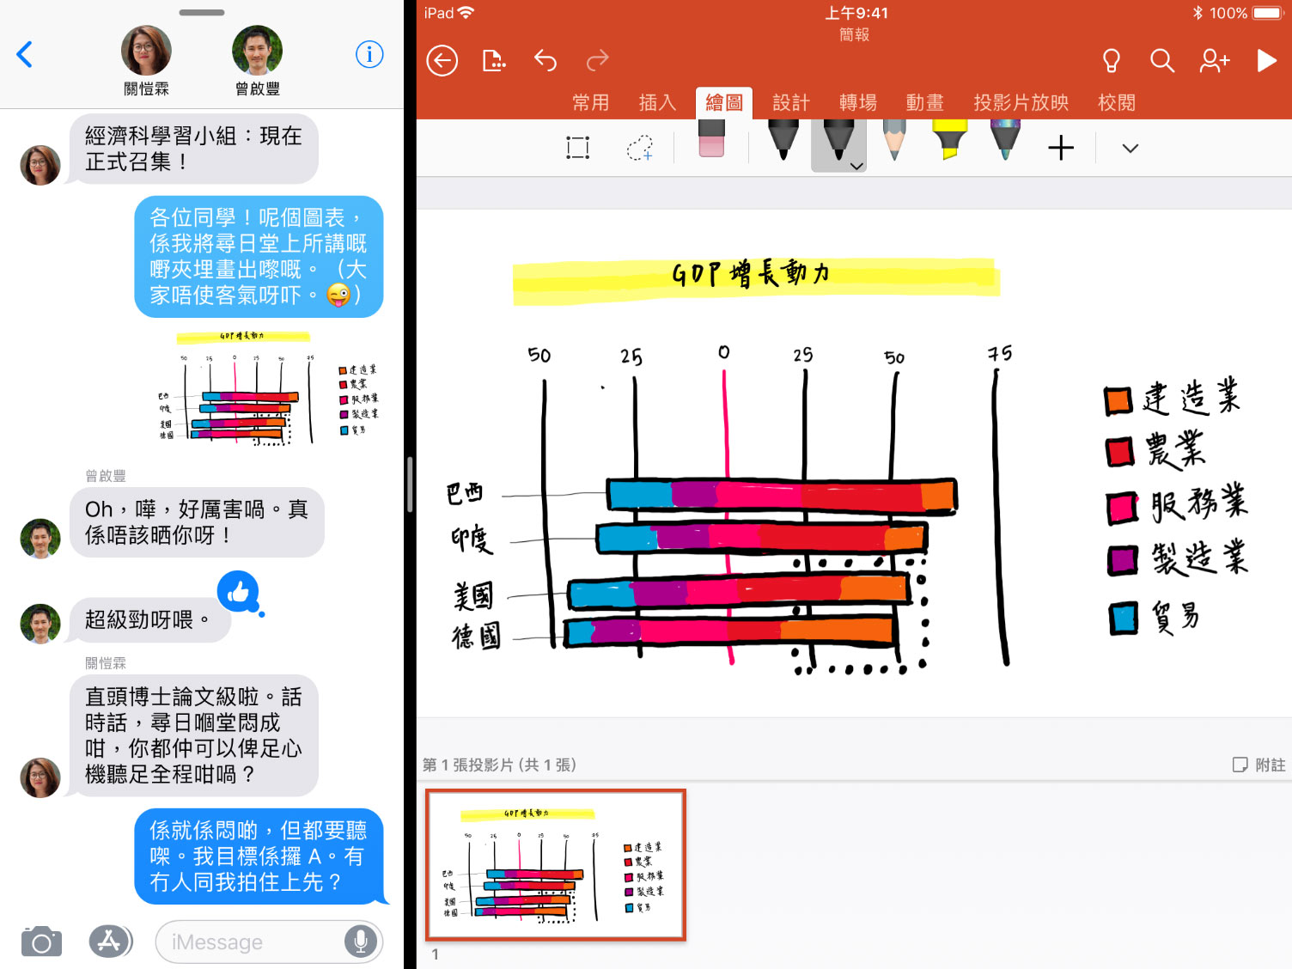
SPECIAL PRIVILEGE OFFER for HK.SHOP.COM
2018 iPad 32G + Pencil + AirPods + Screen protector
HK$4,832
HK$4,488 (8% discount) Period: May 13-20

Slide 11
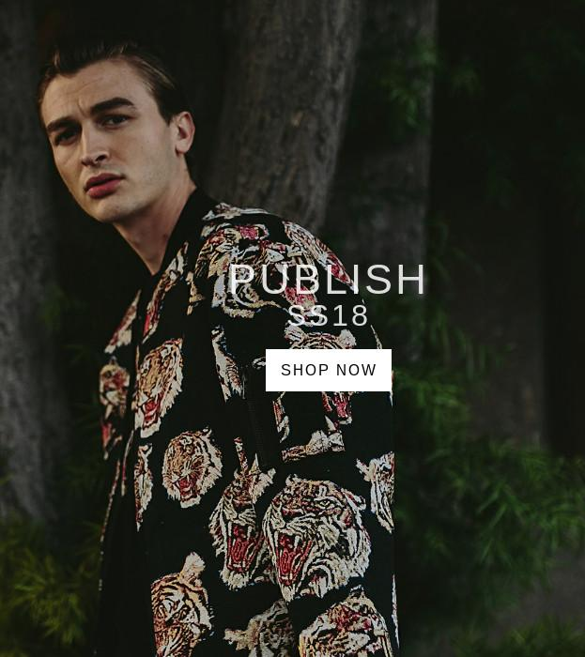
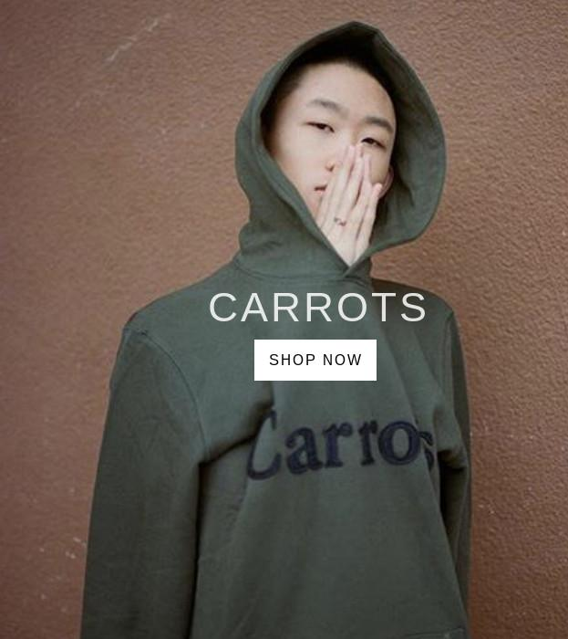
網上商店
Online Store
Founded in 2009, popcorn has been a unique fashion party and retailer that offers various renowned branded collections of street-wear. Popcorn maintain outstanding sales by tracing and selling the newest quality yet affordable fashion wears to customers. Brands include DICKIES, SUPREME, STUSSY, UNDEFEATED, HUF, RED WING, and etc.

Slide 12
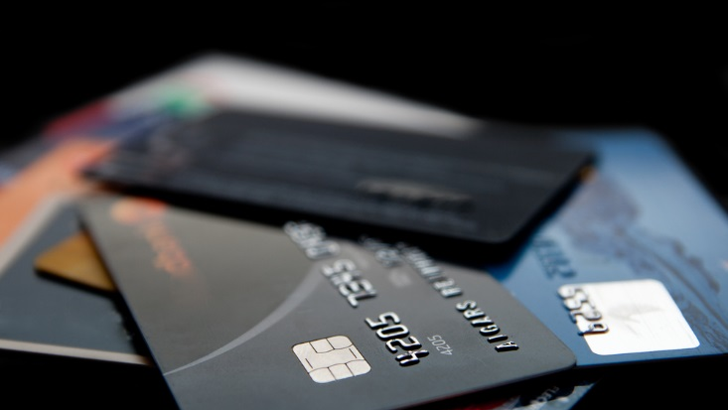
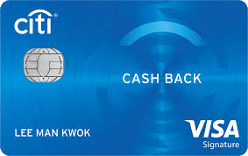
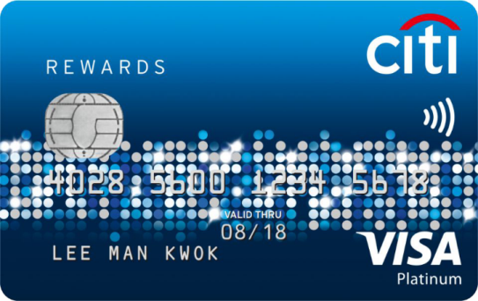
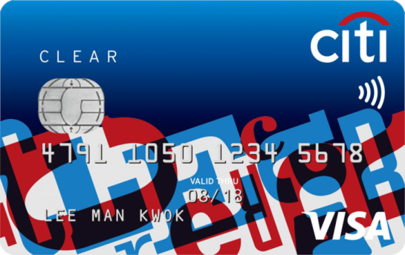
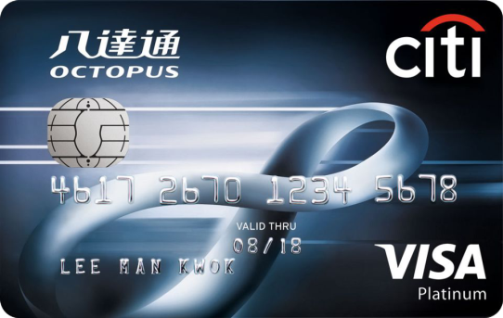
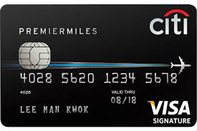
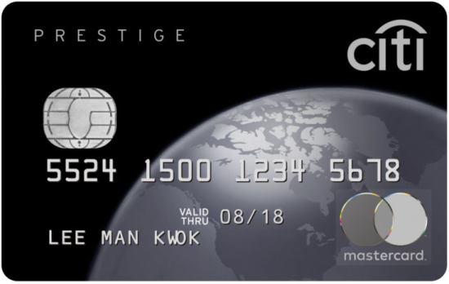
Online Store

Slide 13
Online Store
FoodWise is a brand new Hong Kong-based concept store that inspires health and wellbeing through real food.
FoodWise in-store experience is tailored to fit the everyday needs, tight budget and lifestyle of Hong Kong’s health-minded consumers.

Slide 14
One more …
COMING SOON!

Slide 15
COMING SOON!
COMING SOON!

